Slide 1
Transition Packet
We’re Moving Signs, Arrows

Slide 2
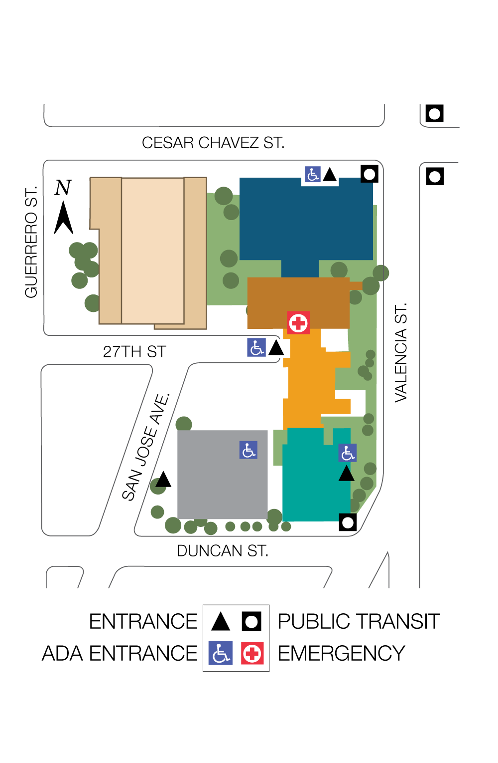
We’re Moving
As of August 25th XXXXXXXX will be located in the:
Monteagle Building Floor X, Room XXX
Monteagle Building

Slide 3
We’re Moving
As of August 25th XXXXXXXXX will be located in the:
1912 Building Floor X, Room XXX
1912 Building

Slide 4
We’re Moving
As of August 25th XXXXXXXXX will be located in the:
1957 Building Floor X, Room XXX
1957 Building

Slide 5
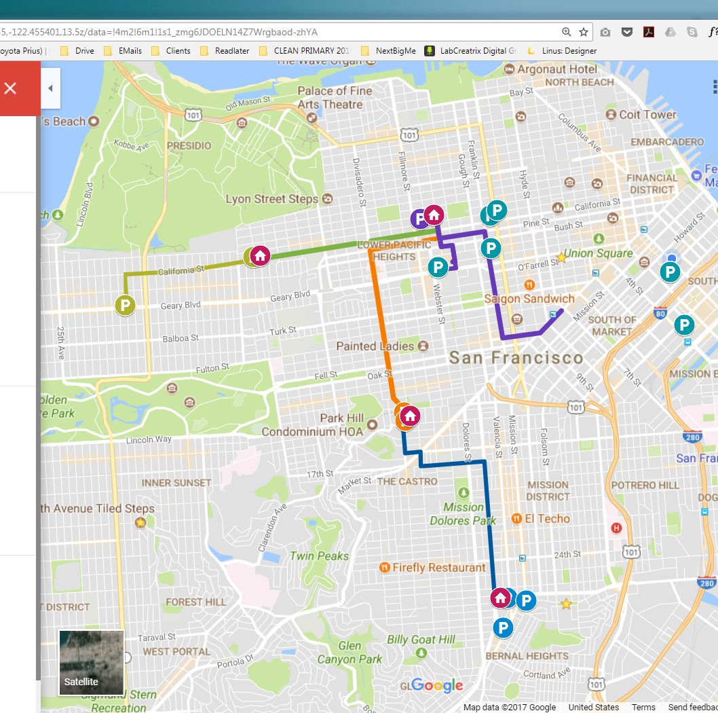

We’re Moving
As of August 25th xxxxxxxxxxxx will be located at Mission Bernal Campus in the:
Monteagle Building 1580 Valencia Street Floor X, Room XXX
Pac Campus
Cal Campus
Van Ness
Davies
Mission Bernal
Notes:
Next slide for selecting your location

Slide 6
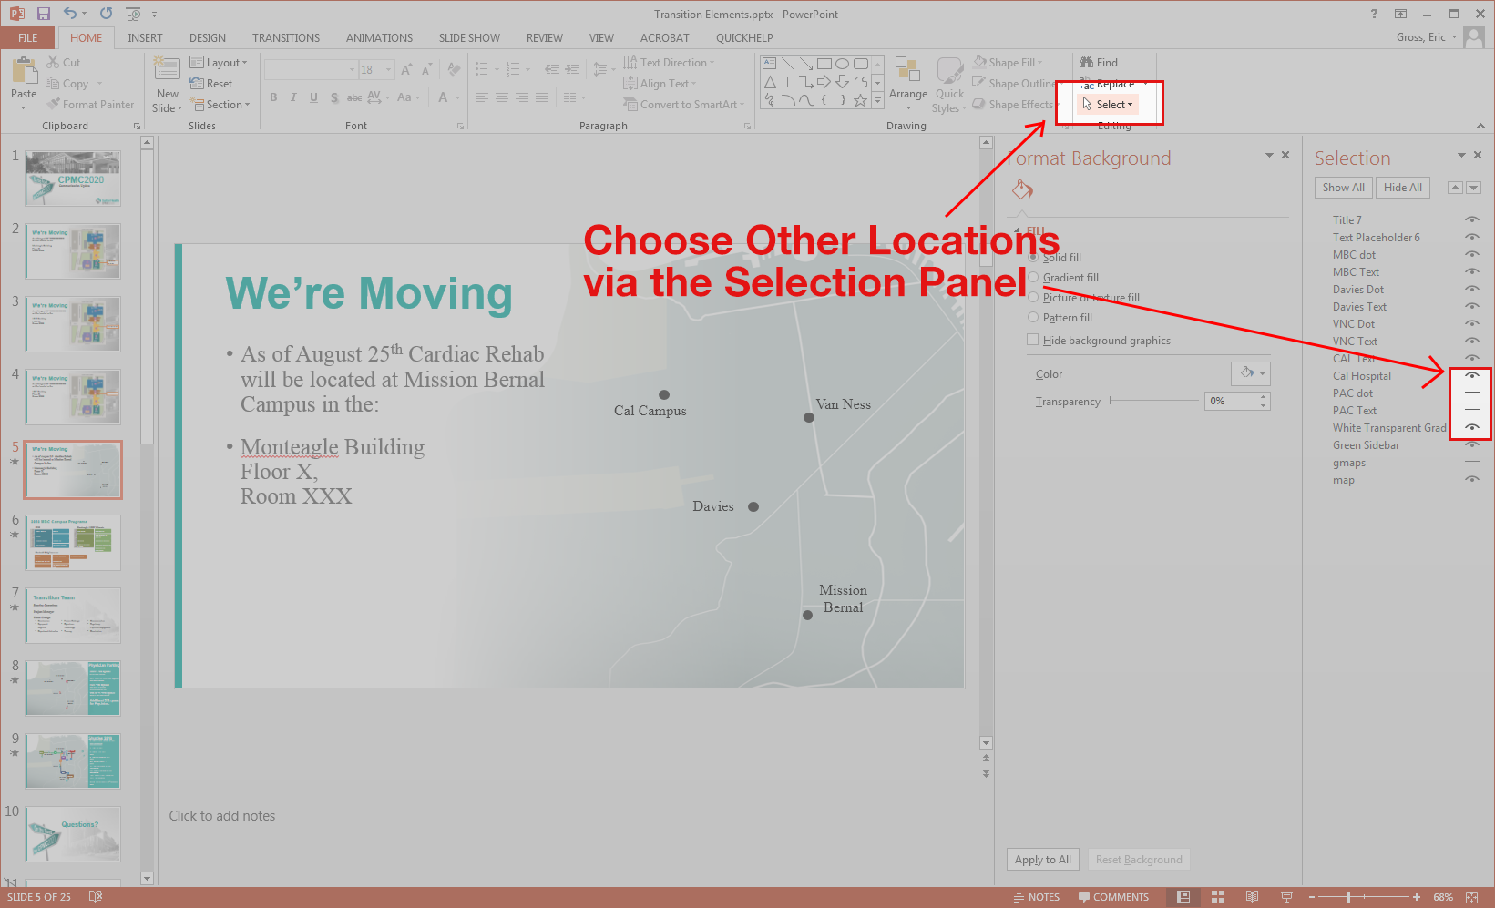

Slide 7

Shuttles 2018
B: BART Civic Center to PAC
Every 10min AM/PM
Every 30min Midday
C: CAL to PAC
30min
D: DAVIES to PAC
30min
K: Kabuki Hotel to PAC
20min
MB: MB to DAVIES
30min
JC: JAPANTOWN to PAC
10min AM/PM
GG: Geary Garage to CAL
20min AM/PM
SAC: BART Civic Center to 1825 Sacramento
30min PM Only
MB24: MB to BART 24th Mission
30min
Pac Campus
P
P
SAC
P
GG
P
C
Cal Campus
P
Van Ness
P
P
P
JC
D
B
P
Davies
P
MB
MB24
Mission Bernal
P
P

Slide 8
Visitors & Non-Emergency This Way

Slide 9
Visitors & Non-Emergency This Way

Slide 10
Visitors & Non-Emergency This Way

Slide 11
Visitors & Non-Emergency This Way

Slide 12
Visitors & Non-Emergency This Way

Slide 13
Emergency Patients this way

Slide 14
Emergency Patients this way

Slide 15
Emergency Patients Straight Ahead

Slide 16
Visitor and Patient Shuttle

Slide 17
Visitor and Patient Shuttle

